Slide 1

SPAM DETECTION
Abacu Abel Armel

Slide 2
INTRODUCTION:
The AT&T Spam Detector project started a mission to make a spam detection system. We used advanced methods in language processing and machine learning. This presentation explains the ways we did things, the models we tried, and the important things we learned. Let's dive into the details.

Slide 3
PROJECT OVERVIEW:
Our project focused on creating a spam detection system using both traditional machine learning methods and advanced pre-trained models. We aimed to assess how well different models could classify messages as either spam or not spam (ham).

Slide 4
TOOLS & LIBRARIES:
We used several important tools and libraries in our project, such as Python, Pandas, NumPy, Matplotlib, Seaborn, TensorFlow, Scikit-learn, Transformers, and TensorFlow Hub. These tools helped us analyze and process data, build models, and visualize results.

Slide 5
TOOLS & LIBRARIES:
We used several important tools and libraries in our project, such as Python, Pandas, NumPy, Matplotlib, Seaborn, TensorFlow, Scikit-learn, Transformers, and TensorFlow Hub. These tools helped us analyze and process data, build models, and visualize results.

Slide 6
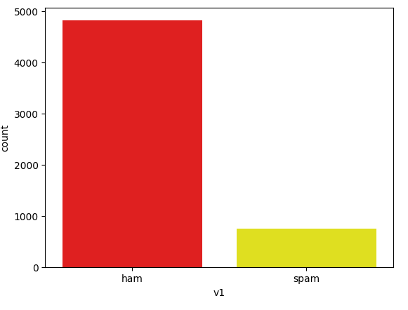
DATA EXPLORATION:
we explored the data by analyzing its structure and visualizing how spam and non-spam (ham) messages are distributed in the dataset.
13.41% of the messages in the dataset are identified as spam.

Slide 7
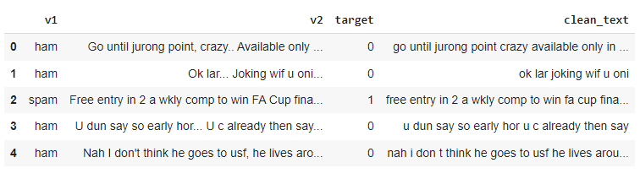
PREPROCESSING:
To prepare the data for model training, we Performed text cleaning and labeling processes, ensuring the dataset was ready for effective evaluation

Slide 8
MODELS:
We set up basic models like Logistic Regression and Naive Bayes as a starting point. These baseline models provided a foundation for us to compare and evaluate more advanced approaches.
We designed a customized embedding model to demonstrate the effectiveness of a lightweight approach. This model showed promising results in detecting spam messages.
The BERT-ELECTRA model, pre-trained on a large dataset, showed competitive performance in spam classification, highlighting its potential.
Additionally, the RoBERTa model, specifically pre-trained for our spam detection task, performed exceptionally well, surpassing other models in terms of precision, recall, and f1-score.

Slide 9
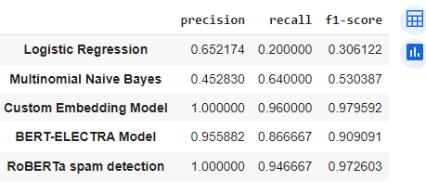
MODEL COMPARISON:
We conducted a thorough comparison of all the models, focusing on metrics like precision, recall, and f1-score. This analysis gave us a comprehensive understanding of how well each model performed.

Slide 10
CONCLUSION:
The pre-trained RoBERTa model was the most effective in filtering spams, achieving a 5% spam rate. Implementing it from the transformers library was easy and efficient. Our custom light embedding model also performed well, suggesting that bigger models aren't always necessary, especially considering size constraints.

